Slide 1

AdventureWorks Sales & Customer Insights Dashboard
Power BI Project by Navya Sree Madagoni

Slide 2
Project Overview
Objective:
Build an end-to-end Power BI dashboard for AdventureWorks to
track business performance using raw sales, returns, and customer
data.
Scope:
Transform raw CSV data
Build relational data model
Create calculated metrics (DAX)
Design interactive dashboards

Slide 3
Tools And Technologies
Tool | Purpose
Power BI Desktop | Dashboard Creation & Modeling
Power Query | Data Cleaning & Transformation
DAX | Calculated Columns and Measures
Relational Data Model | Star and Snowflake Schema

Slide 4
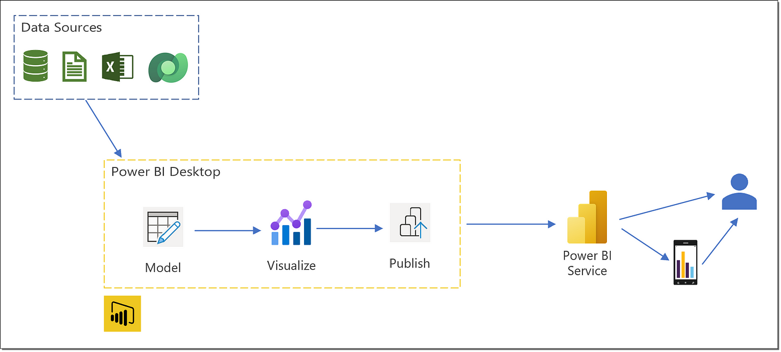
Data Sources
Files Used:
Sales Transactions
Product Info
Customers
Sales Territories
Returns

Slide 5
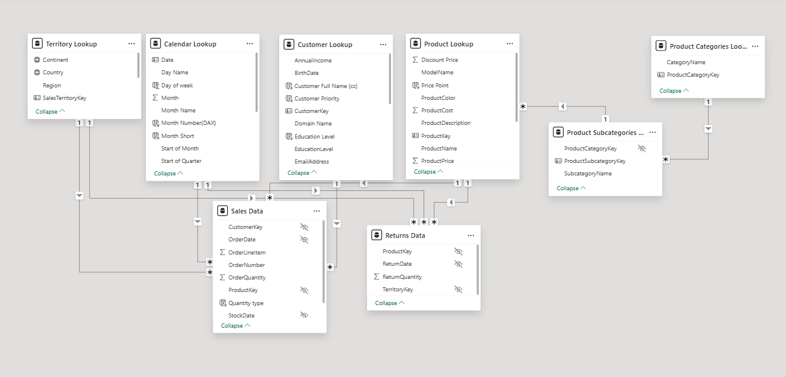
Data Model
Built using fact & dimension tables
Star schema for Sales data
Snowflake schema for Products
One-to-many relationships (PK-FK)
Applied best practices: field hiding, naming, clean layout

Slide 6
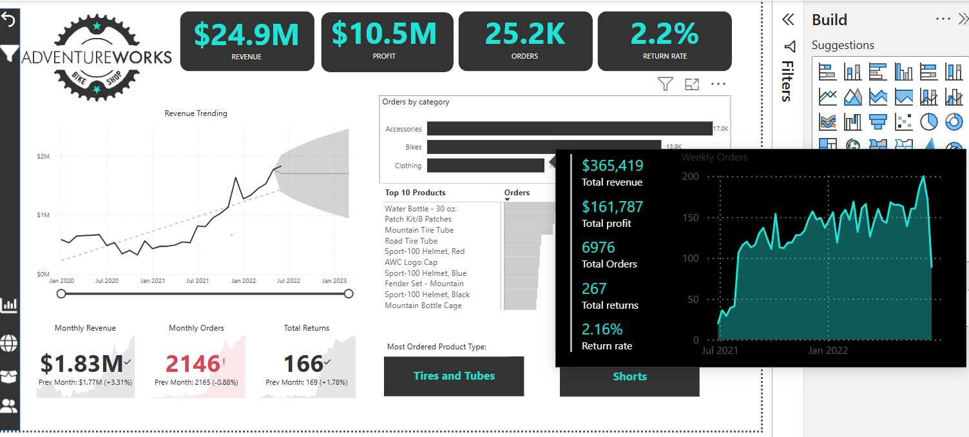
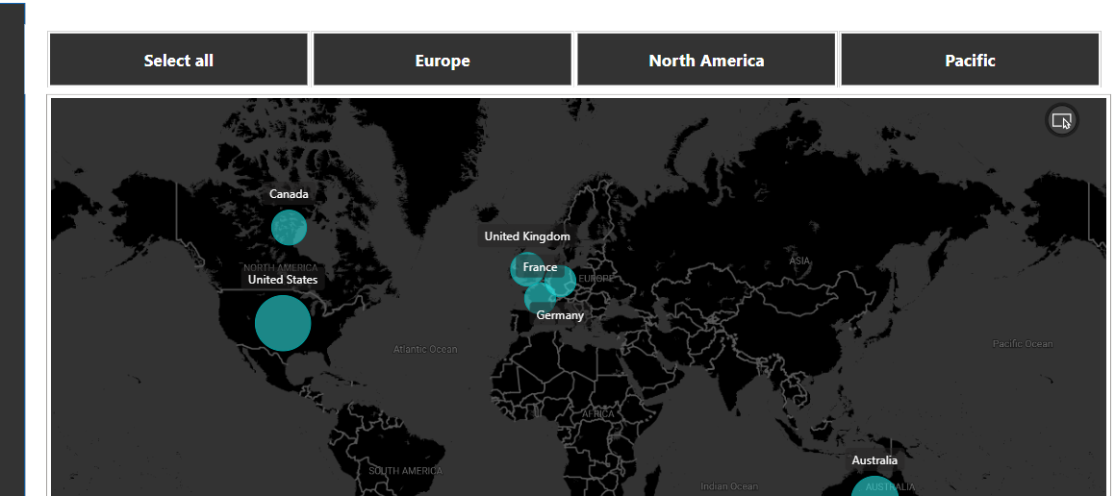
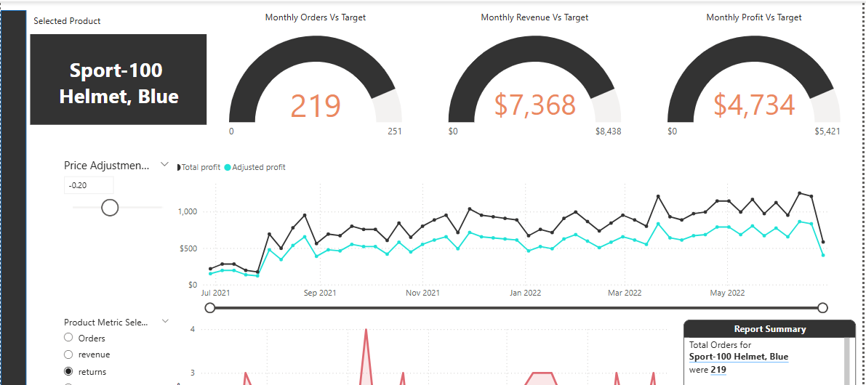
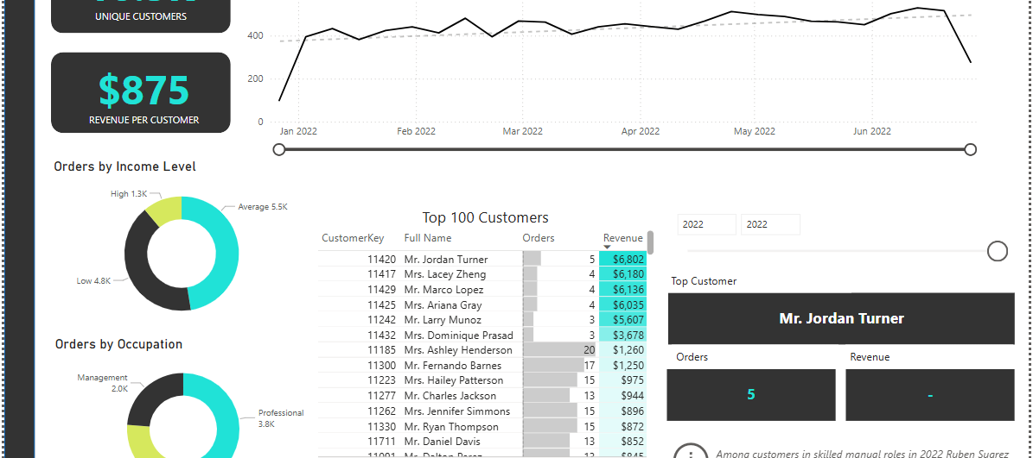
Dashboard Overview
Dashboards Created:
Executive Dashboard
High-level KPIs like Total Revenue, Profit, Orders, and Return Rate
Trend analysis with filters for region and time
Map Dashboard
Geo-based insights using maps to analyze sales and returns by territory
Highlights regional performance across the globe
Product Dashboard
Tracks performance of product categories
Visualizes top-selling products, product returns, and revenue contribution
Customer Dashboard
Segmentation based on income, education, and parental status
Identifies high-value customers and customer behavior patterns

Slide 7
Outcomes & Insights
Revealed top products & regions driving profit
Identified customer segments with highest revenue
Monitored return trends by product and territory
Enabled interactive, self-serve analysis for stakeholders

Slide 8
Skills Demonstrated
Power BI workflow (ETL → Modeling → Visualization)
DAX for calculations and logic
Data modeling with star & snowflake schema
Visual storytelling and business insights

Slide 9

Thank you

